Slide 1
Tables & Forms in HTML
Sandeep G

Slide 2
Who Am I?
Engineer / Front End developer
Worked in Software AG, MSFT, SAP
~9 years of experience
Worked in React JS, TypeScript, JS, CSS, HTML

Slide 3

Agenda
HTML Tables
HTML Forms
Semantic HTML

Slide 4
HTML Tables

Slide 5
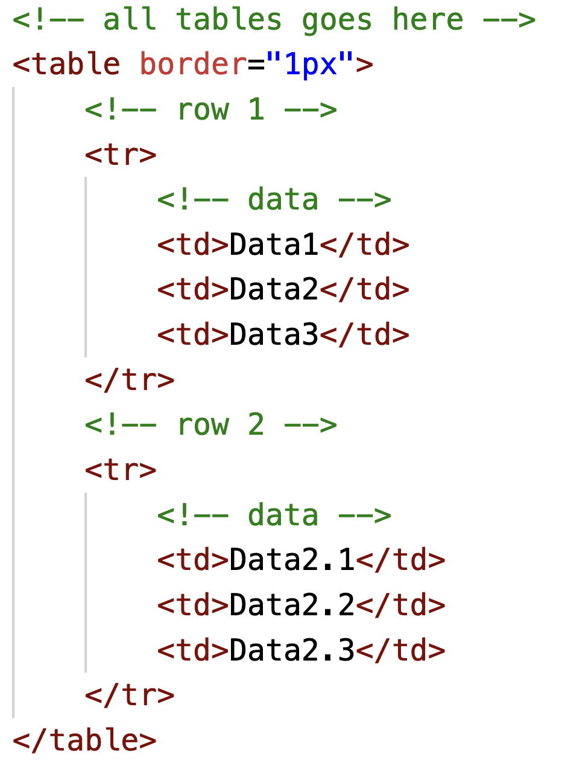
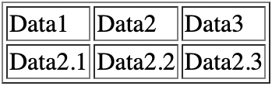
Introduction to Tables
Tables are everywhere Attendance register, Train Timetable, Stock Reports, etc.
In HTML we use <table> tag, in order to make tables. <tr> - Row <td> - Data

Slide 6
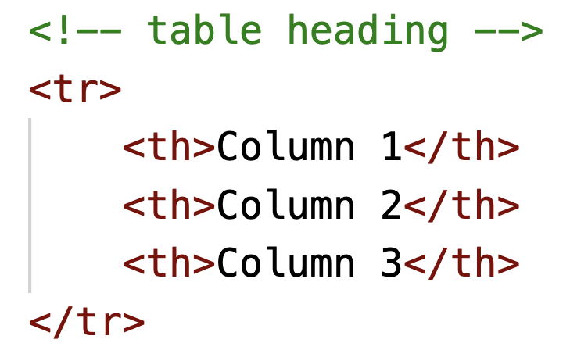
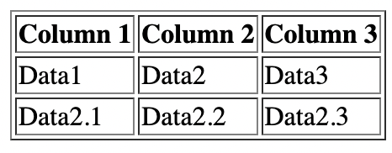
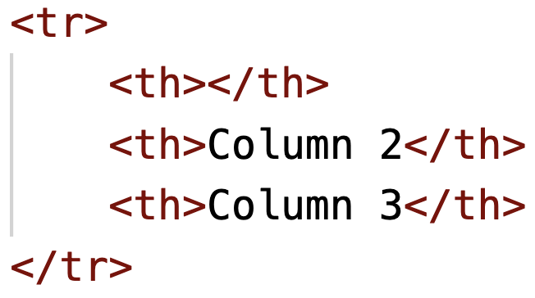

Table Heading
We use <th> tags to declare a table heading.
If we leave an empty td/th tags, that cell would be empty.

Slide 7
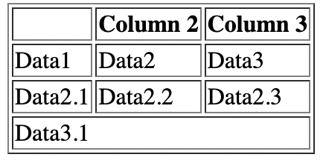
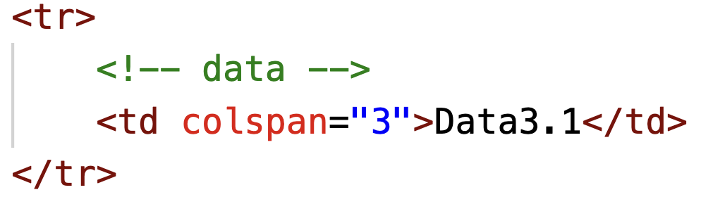
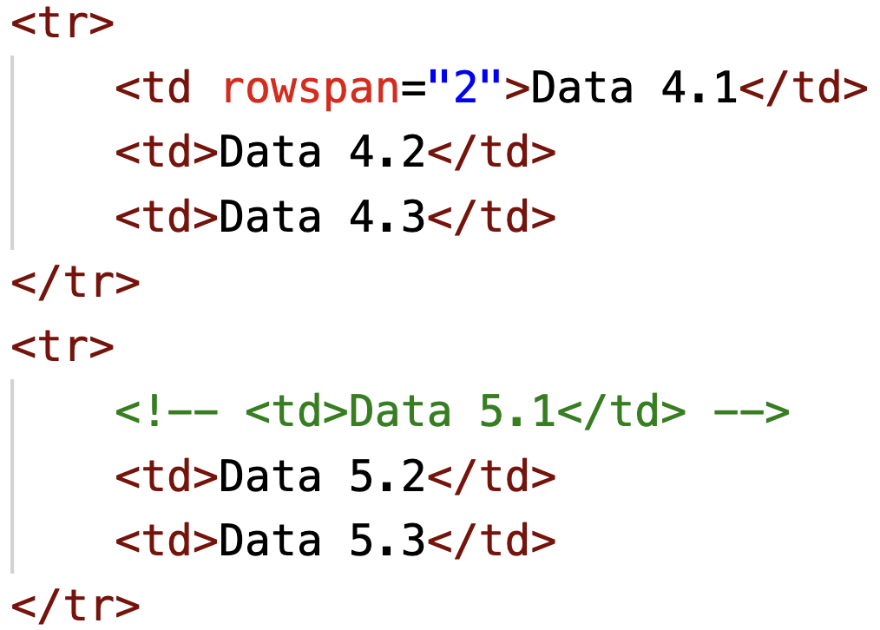
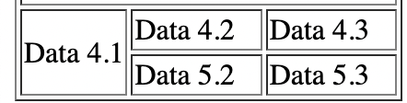
Spanning columns and rows
Using the attribute “colspan” you can merge multiple columns in a row.
Using the attribute “rowspan” you can merge multiple rows.

Slide 8
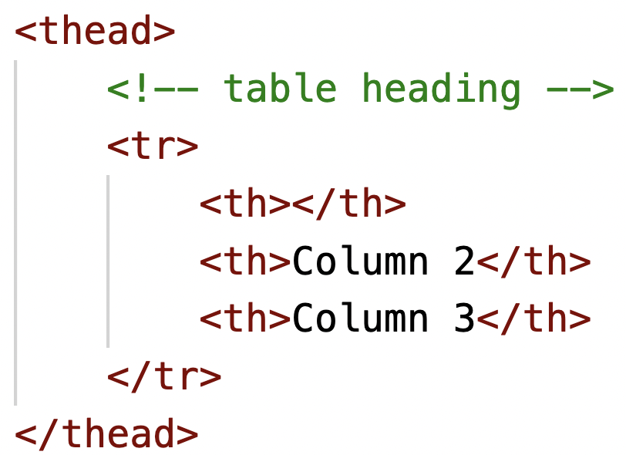
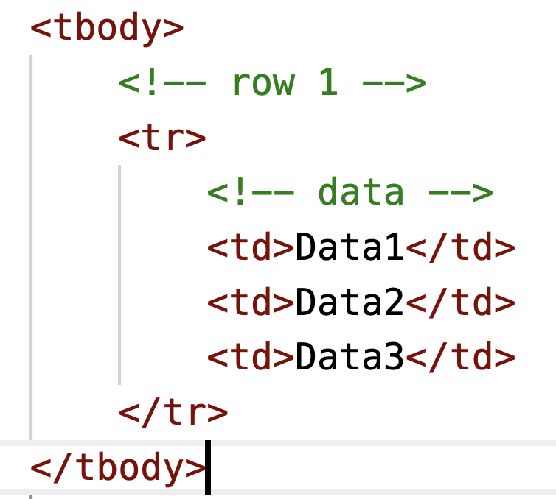
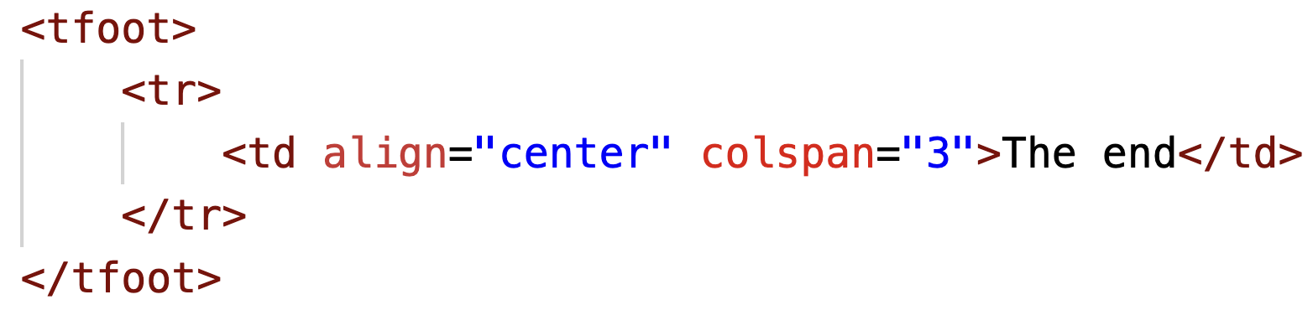
THead, TBody, TFoot
HTML gives us the options to group the heater, main rows and footer. This can be used by the browser by browser, when showing a large table.
By using these table header can stay in top and there is scroll for the contents, when the table is long.

Slide 9
HTML Forms

Slide 10
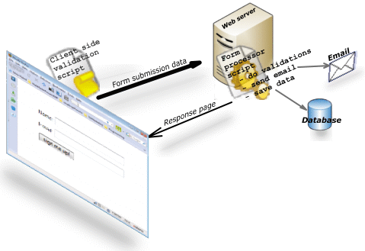
Intro to Forms
We use physical forms all the time - Bank applications, registrations, buying an insurance, etc.
Just like physical forms, HTML forms are responsible for collecting information from user and send it to backend for processing.

Slide 11
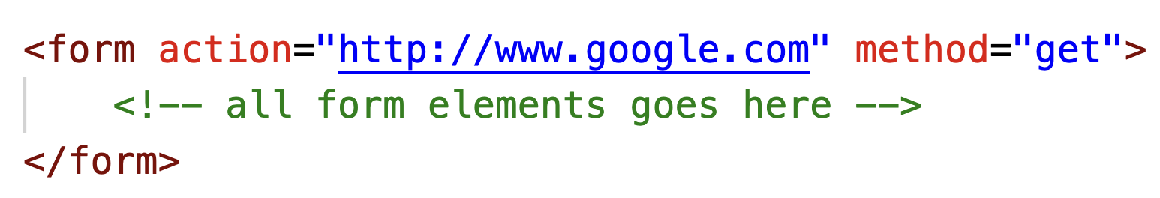
HTML Form
Form tag is used to contain all the form elements and declared by <form>
It contains attributes -
Action - the address of the backend
Method - signifies the type of request (GET/POST)

Slide 12
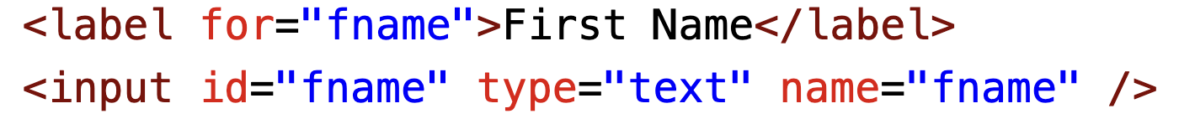

HTML Form Elements
Text Input - responsible for creating an input field in our form. It contains the following attributes -
Type: type of input it can accept
Name: used by the server to know about the data
Id: unique identifier
Label - It is used to describe an input box.

Slide 13
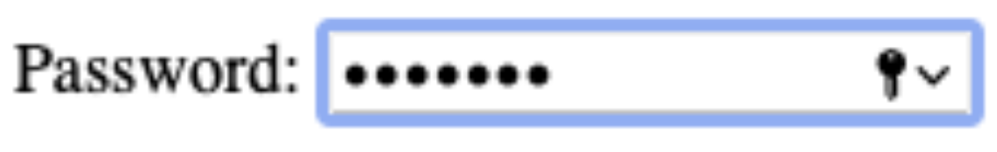

HTML Form: Password & Textarea
Password Input: replaces the text with asterisk(*) when you type. You must have saw when you type in your password.
TextArea: Used when user need to write more information at once. It contains the attributes like
Rows: specifying the number of visible rows
Cols: specifying the number of visible columns

Slide 14

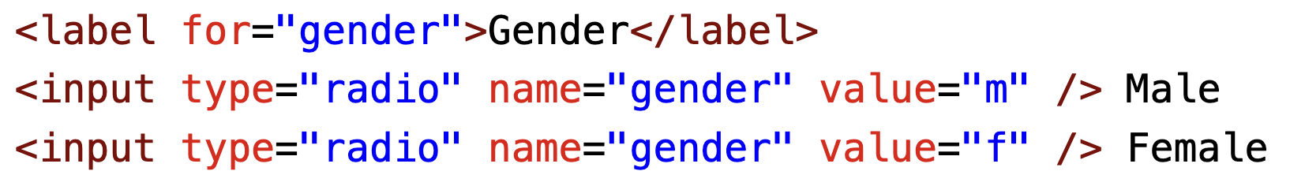
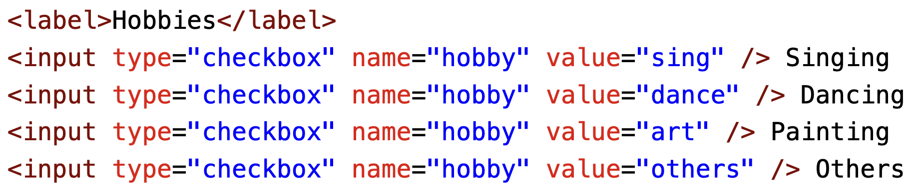
HTML Form: Radio & Select dropdown
Radio element: It allow users to pick just one of a number of options.
Checkbox element: Allow users to select (and unselect) one or more options. Written by type=”checkbox”

Slide 15

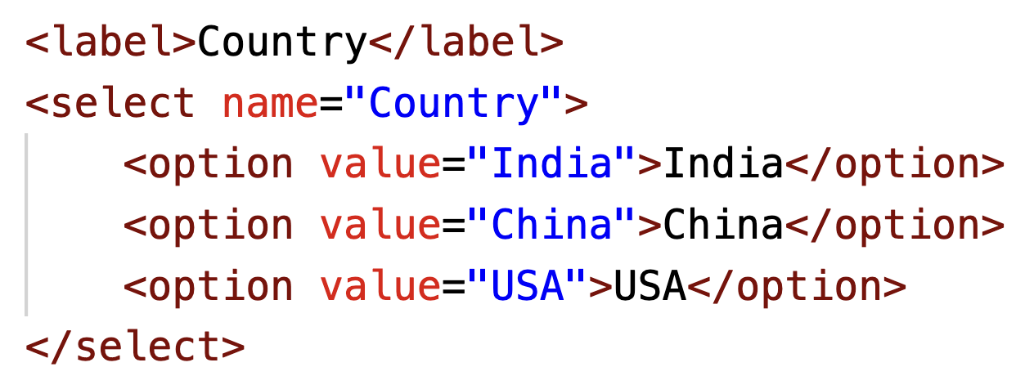

HTML Form: Drop-down-list & Submit Button
Select-Options: The <select> <option> tag is used to create a dropdown list.
Submit Button: Used to send the form data to the server. It contains the attribute “value” to specify the text on button.

Slide 16
Semantic HTML

Slide 17
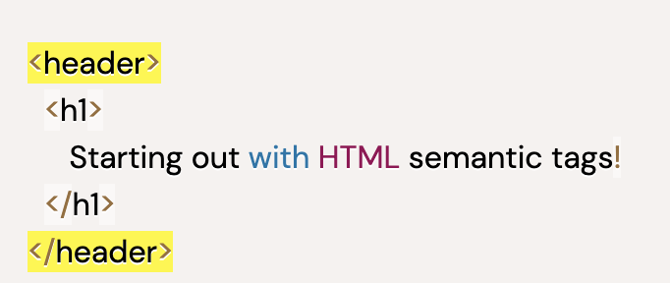
Semantic HTML
Specifying the content inside
Semantic elements provide information about the content between the opening and closing tags.
Some of the examples of semantic elements -
<header> : Usually contains either navigational links or introductory content containing <h1> to <h6> headings.
<nav>: A <nav> is used to define a block of navigation links such as menus and tables of contents.
<main>: <main> is used to encapsulate the dominant content within a webpage
<article>: Can hold contains like article, blogs, magazine, etc.
<aside>: Used to give additional information.
<figure>: used to encapsulate media such as an image, illustration, diagram, code snippet, etc.
<footer>: contains the copyright information, along with links to the privacy policy and terms and conditions.
Screen readers and web browsers are better able to identify that whatever is inside of the tag is the bulk of the content.

Slide 18
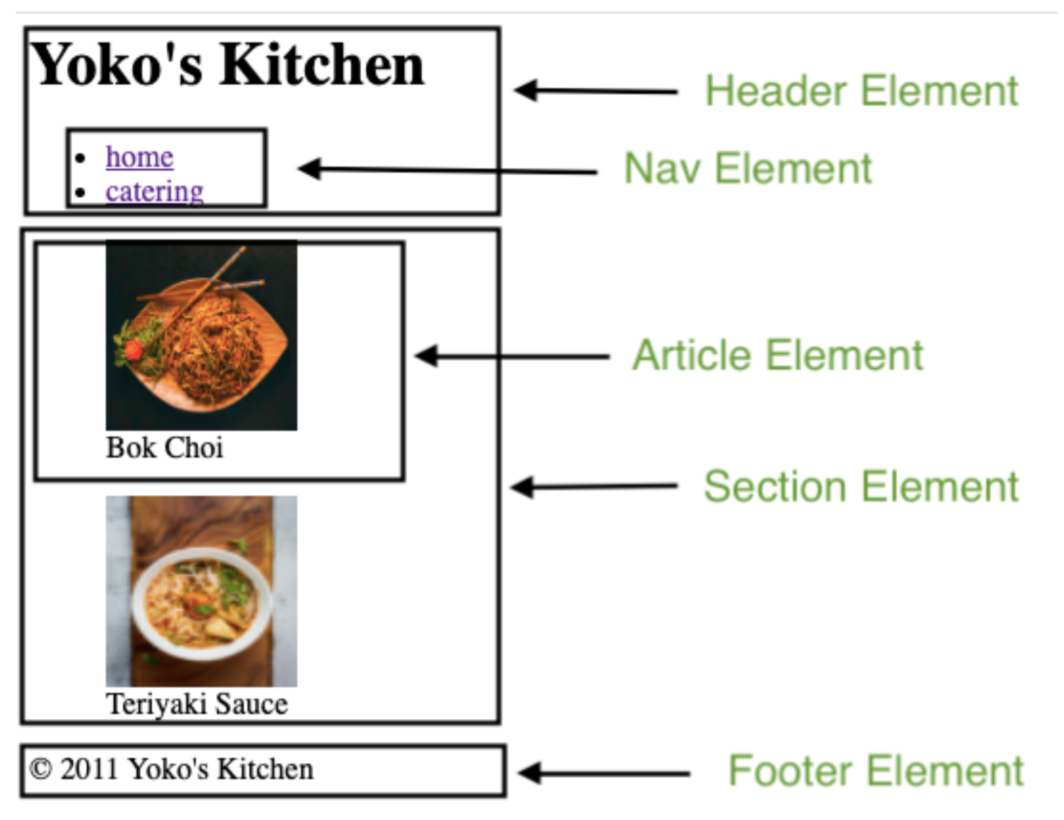

Slide 19
Thanks and Happy coding!

